Slide 1
DIP392-LabCyberDocs
Nicolas Cholin 250AEB034
Bekassyl Adenov 221ADB130
Rofig Ashumov 221ADB172
Batex Bafika 250ADB026
Ayham Saifan 250ADB025
[https://github.com/CabernetOgygiaVillaBanquet/team5-section005-finalproject]

Slide 2

01
Project overview and motivation
🔍 Problem
Managing and standardizing documentation for projects, machines, and events in FabLab is often inefficient, fragmented, and lacking version control. Manual uploads and inconsistent review processes hinder collaboration and transparency.
👥 Target
Users Innovative startups documenting prototyping workflows Academic institutions and research labs contributing to shared knowledge Private organizations managing equipment usage and events
🌐 Relevance
The platform fosters secure, structured, and version-controlled documentation practices, aligning with the principles of open science, digital fabrication standards, and collaborative innovation. It bridges the gap between local contributions and global repositories like GitHub.

Slide 3


SLDC Methodology
02
🌀 SDLC Model: Iterative Development
📖 Description An evolutionary model emphasizing repeated cycles of planning, design, implementation, and evaluation. Each iteration builds upon the previous one, allowing for early prototypes and continuous refinement.
🎯 Rationale for Selection
Encourages frequent stakeholder feedback to align with evolving requirements
Supports incremental delivery, enabling early detection of design flaws
Ideal for projects like LabCyberDocs where user needs emerge progressively during development

Slide 4
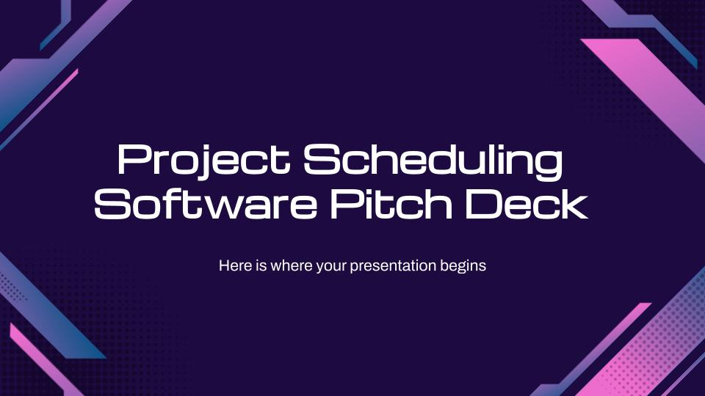

Requirements Gathering & Analysis
03
📋 Requirements Gathering & Analysis
🛠️ Methods Used Requirements were elicited through a combination of client consultations, structured Q&A sessions, and domain research into FabLab workflows and documentation standards.
📌 Key Assumptions Made
All contributions must undergo admin review and approval via Pull Requests
The platform must support local authentication for users without GitHub accounts
Robust security is essential to safeguard uploads and enforce role-based access control

Slide 5

Software Requirements Specification
04
🧾 Software Requirements Specification
✅ Functional Requirements
Enable users to upload documentation, triggering automatic Pull Request (PR) creation on GitHub
Provide dual authentication: GitHub OAuth and secure local login
Offer an admin dashboard for streamlined review, validation, and approval of contributions
⚙️ Non-Functional Requirements
Enforce file type and size restrictions for upload security
Ensure responsive design for both desktop and mobile devices
Implement automated email notifications for admin alerts

Slide 6

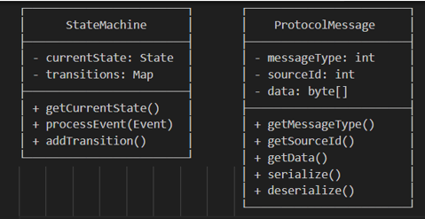
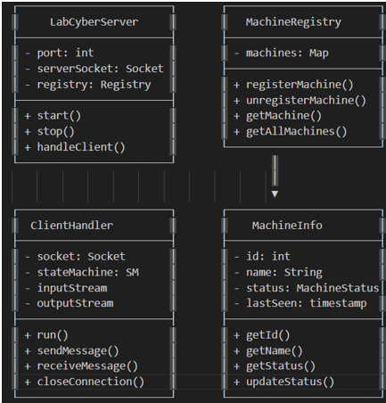
System and Software Design
05
🔧 Chosen Architecture
Composition-Based Service Architecture:
A modular design where functionality is distributed across loosely coupled services (e.g., Upload Service, GitHub Service, AuthService). This approach promotes flexibility, scalability, and ease of maintenance, aligning well with React's component-driven structure and microservice principles.
🔄 Considered Alternative
Inheritance-Based Model
Initially explored a class hierarchy using inheritance (e.g., Project, Machine, and Event as subclasses of a common parent). However, it was rejected due to its rigid structure, tight coupling, and lower adaptability to evolving requirements.

Slide 7


Implementation Phase
06
💻 Implementation Phase
🧱 Technology Stack
Frontend: React with functional components and Hooks for state and effect management
Backend: Node.js with Express, enabling scalable RESTful API services
Authentication: Integrated GitHub OAuth and secure local login using Passport.js
🤝 Team Collaboration Development was structured around a feature-based workflow, with isolated Git branches for each component (e.g., Upload Module, Admin Dashboard, Auth System), ensuring efficient parallel development and seamless integration.
🔐 Key Implementation Highlights
Secure file handling with size/type validation and blocked extensions
Fully responsive interface optimized for both desktop and mobile
Automated GitHub PR creation and real-time admin notification system

Slide 8
Testing Strategy
07
🔍 Approach: Black-Box Testing
Focused on validating the system's functionality strictly from the user's perspective, independent of internal code structure.
🎯 Key Testing Areas
📐 Techniques Applied
Input validation: File types, sizes, and required fields
Authentication workflows: GitHub OAuth and local login mechanisms
GitHub integration: Automated Pull Request creation and error handling
UI responsiveness: Cross-device behavior and usability testing
Equivalence partitioning to group valid and invalid inputs
Boundary value analysis for file sizes, field lengths, and login credentials

Slide 9
Test Results and Validation
08
Test Case | Results and Validation
Email notification “Upload triggers admin email” | The admin will receive an email notification for each pr. (labcyber@ptcc.fr)
Upload a “.exe” file (invalid format) | After the attempt of uploading, it will not accept a faulty format, and it is validated by an error message
Upload file size > 25MB (Larger than the system limit) | The maximum amount is 25 MB, and the test shows an error message of the it exceeds the size limit
Upload a valid PDF report to "Project" with all dropdowns selected | Upload accepted, visual summary displayed, PR created, thank-you message shown
Empty form submission | Refuses the upload option as it needs a file between 1 – 25 mb to accept

Slide 10

Process Reflection and Lessons Learned
09
Challenges
Managing GitHub API rate limits effectively to ensure uninterrupted functionality without hitting quota ceilings.
Implementing robust file security protocols while efficiently handling varying file sizes to maintain system integrity and performance.
Lessons Learned
Recognized the critical advantage of modular architecture in enhancing scalability, maintainability, and ease of iterative development.
Understood that early and comprehensive requirement clarification is essential to minimize scope creep and reduce costly rework downstream.

Slide 11
Demo Overview
10
Features Highlighted
Seamless dual-mode authentication via GitHub OAuth and local login for enhanced user flexibility.
Integrated file upload system coupled with automated pull request creation to streamline contribution workflows.
Comprehensive admin dashboard enabling effective monitoring, review, and management of submissions.
Demonstration Overview
This demo exemplifies the full Software Development Life Cycle (SDLC), showcasing each phase: Requirements → Design → Implementation → Testing — illustrating a methodical and structured approach to software delivery.

Slide 12

Conclusion and Future Work
11
Conclusion
This project delivers a robust and scalable documentation platform that combines intuitive user experience with secure, automated workflows. By integrating GitHub pull request automation, dual authentication, and a powerful admin dashboard, the solution ensures transparency, control, and ease of use. Its modular architecture supports long-term maintainability, making it ideal for organizations seeking to streamline and secure their documentation processes.
Future Improvements
01
02
03
Enhanced Analytics
Detailed usage metrics and contributor analytics dashboard
Collaboration Features
Real-time commenting system on pull requests
Continuous Maintenance
Regular system updates, security patches, and performance optimization with the client.

Slide 13
Thank You For Your Attention!

